Slide 1
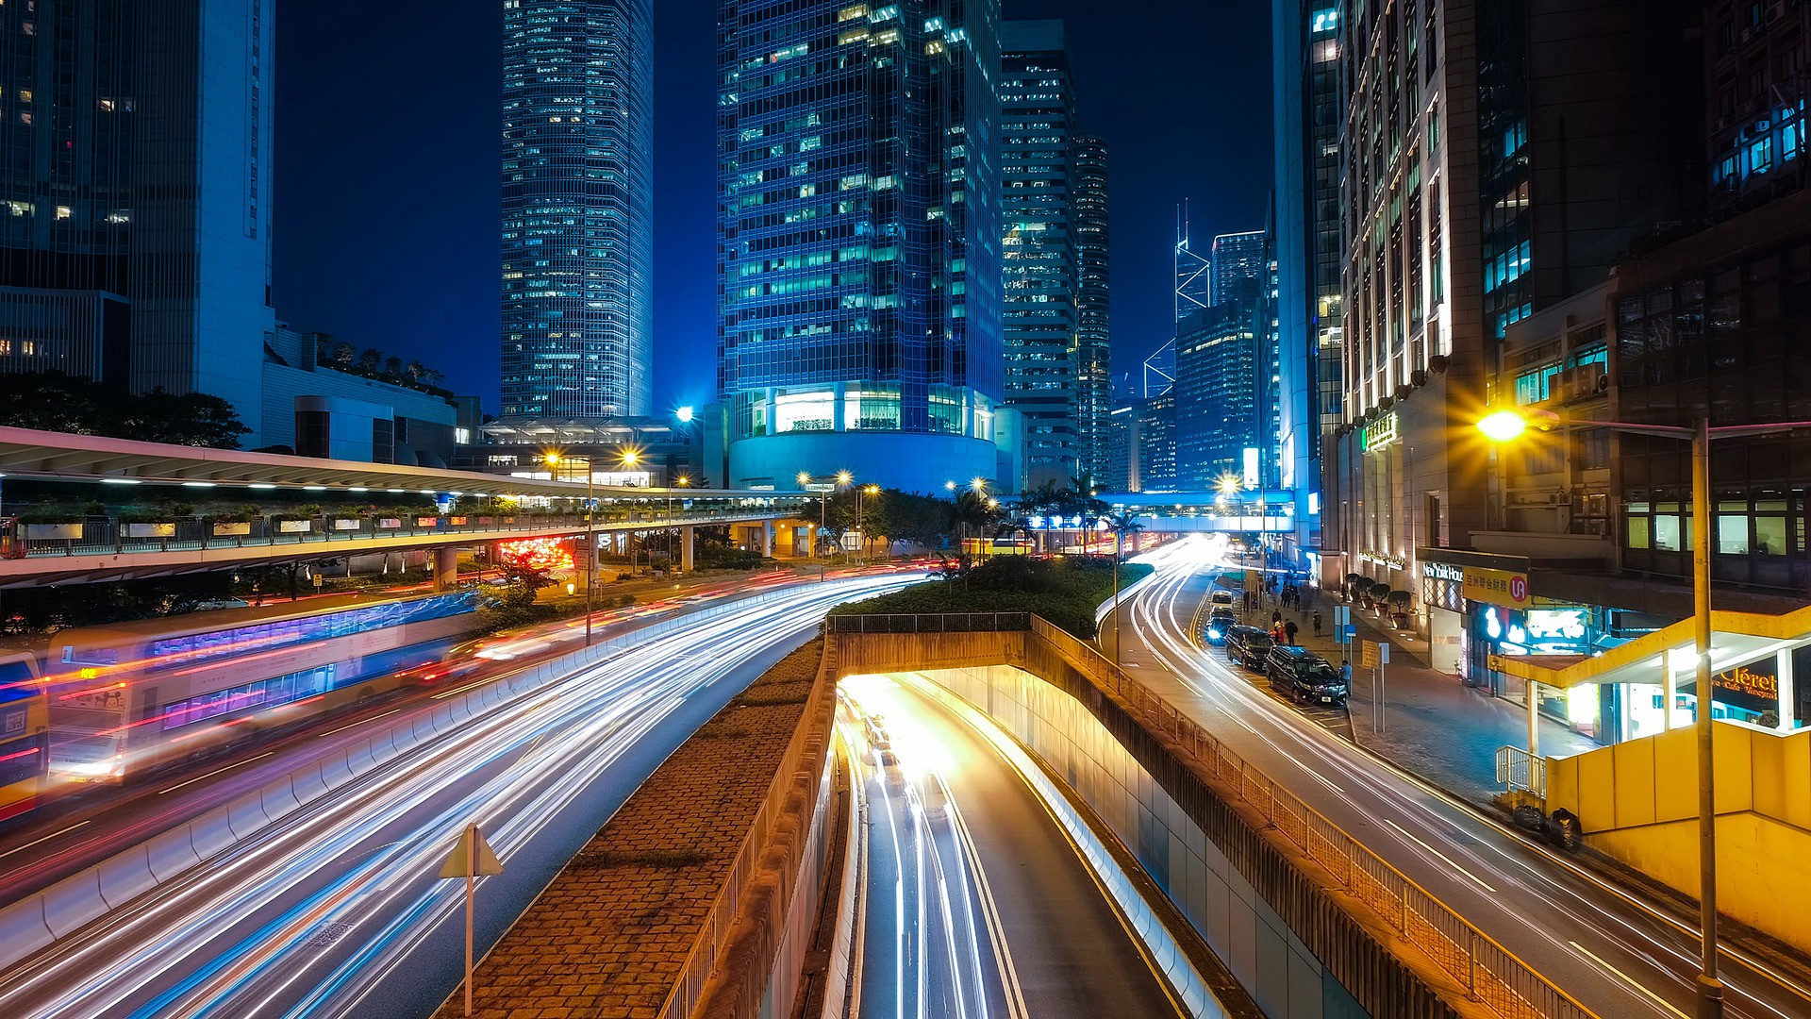
Challenge 1: The brain Prepared by: WOMENGINEERS Khoula Jawwad Jenita Mary john paulose

Slide 2
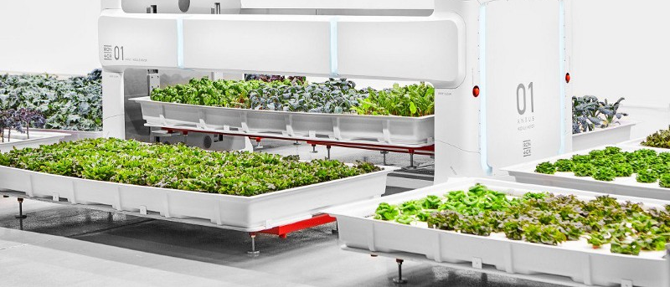
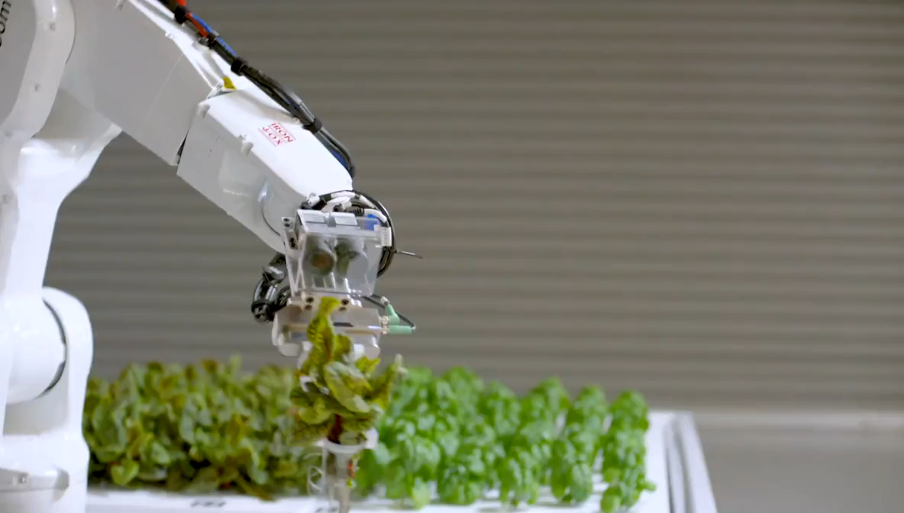
WHAT IS BRAIN?
Software developed by Iron Ox to collaborate different machines on a robot farm
Company’s Grand Vision: Create a fully-autonomous farm where software and robotics fill the place of human agricultural workers
“The Brain” brings the series of robotic arms and movers together
Human inputs are still required
Solves: Shortage of agricultural workers and shipping distance
Notes:
The farm’s non-lettuce consuming staff consists of a series of robotic arms and movers. The arms individually pluck the plants from their hydroponic trays, and transfer them to new trays as the crops increase in size, maximizing their health and output — a luxury most outdoor farms don’t have. Big white mechanical movers carry these various 800 pound water-filled trays around the facility.
At first, making sure these different machines work together was tricky. “We had different robots doing different tasks, but they weren’t integrated together into a production environment,” says Alexander.
So Iron Ox has developed software — nicknamed “The Brain” — to get them to collaborate. Like an all-seeing eye, it keeps watch over the farm, monitoring things like nitrogen levels, temperature, and robot location. It orchestrates where both robot and human attention is needed.
Human inputs required: Currently, workers help with the seeding and post production of crops, but Alexander says he hopes to automate these parts of the process.
For Alexander, he sees it as solving two problems in one: the shortage of agricultural workers and the distances at which fresh produce currently have to be shipped. Rather than eliminating jobs, they are hoping the robots will fill the gaps in the industry’s workforce.

Slide 3
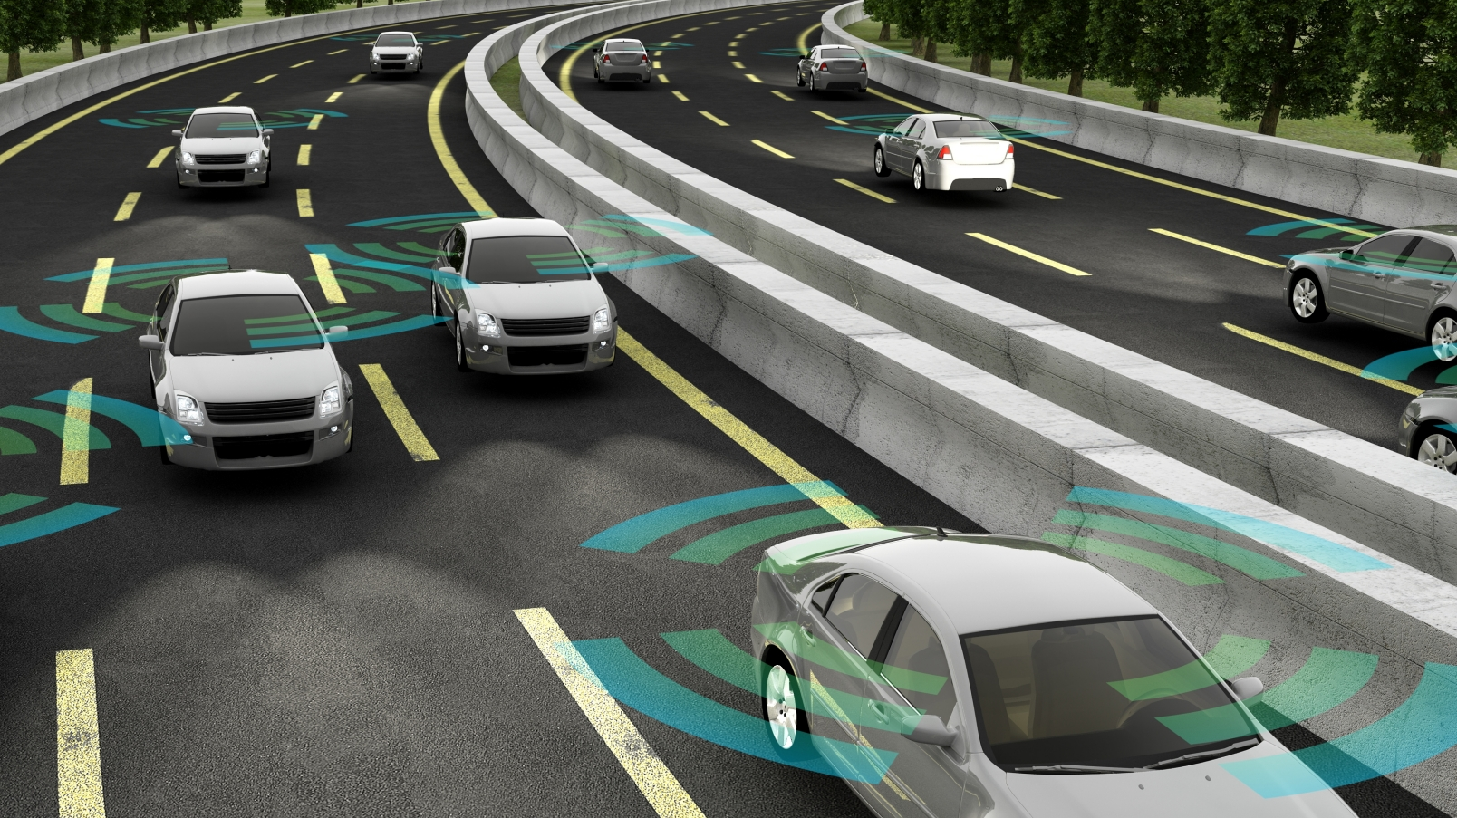
REVERSE ENGINEERING “THE BRAIN”
AI LANES
THE BRAIN CONTROL
AI-GPS
Notes:
Brain is not automatically connected to the regular cars that do not have AI-GPS system, but can still sense the other cars and bystanders

Slide 4

The brain and ai-gps in depth
- Road Network Management: Software: ArcMap
Applications: Attribute Assistant
Database: Road Characteristics, Road network management and local government
- Machine Learning
To learn from the surrounding cars or buses, choose routes that are least dense with traffic
- Artificial Neural Networks
Replicates the way humans learn
- AI-GPS
placed in the car receives signals and information from the brain
Notes:
Road Network Management is a configuration of ArcMap that can be used by mapping technicians to inventory intersections, roads, and physical road characteristics (for example, speed limit, functional class, lane width, and number of lanes); and publish a series of road layers used in maintenance management and transportation planning workflows throughout a public works organization.
The Road Network Management solution is optimized for public works organizations and compliments address editing workflows provided in the Address Data Management map.
Like the heading of A.I., machine learning also has multiple subcategories, but what they all have in common is the statistics-focused ability to take data and apply algorithms to it in order to gain knowledge.
There are a plethora of different branches of machine learning, but the one you’ll probably hear the most about is…

Slide 5
Commercial feasibility
Cost less than normal cars- covers parking and insurance
Educating the public
Makes travel easier
Better at following rules

Slide 6
Overall impact of changes
Faster
efficient
less cost transportation
“The problem is less about building a perfect driving system than training bystanders to anticipate self-driving behavior” – THE VERGE
Notes:
More lights at night

Slide 7
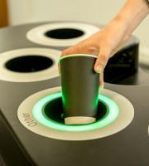
Challenge -2 Waste management
- A product similar to an already existing recycling bin that flashes green LED light at the right disposal hole using X-ray technology
- Reduces the risk of contamination of waste
- Multiple stages is necessary so its constantly updated.

Slide 8
impact
The cost of these specific garbage cans wouldn’t be significantly more expensive seeing as how when produced on a mass level, the prices would be even less. Moreover, the market would be very open to it as well
Once these big companies take this step, it would cause a chain effect causing even more people to implement it. Overall, this would lead to more accurate results from sorting and ensure everything goes in its designated place.

